Slide 1
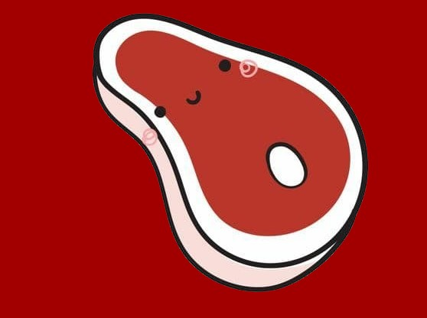
Meat
Martina Segečová
Andrea Mazúchová
Betka Apfelová
Ema Margita Gnidová

Slide 2
OUTLINE:
1. Positive effect of meat
2. Negative effect of meat
3. Meat consumption in Slovakia
4. Organic meat farming

Slide 3
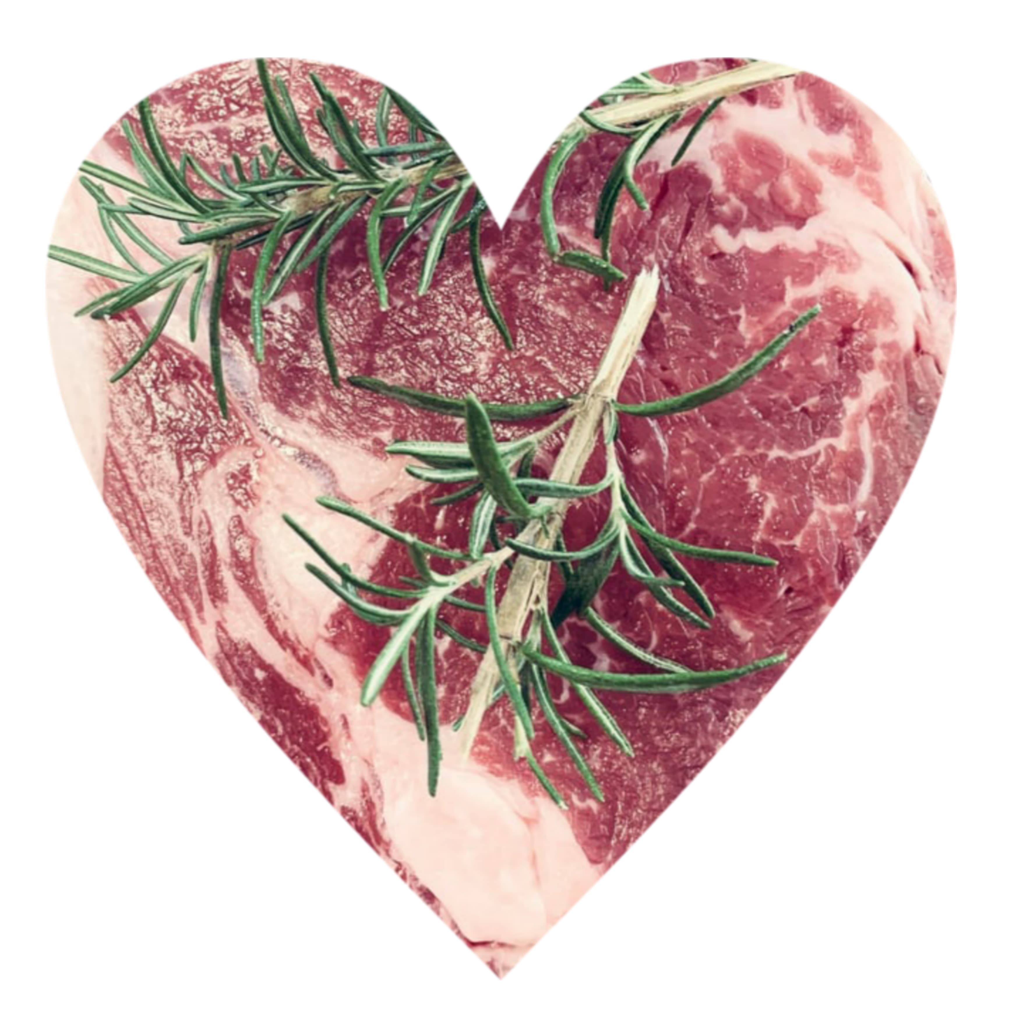
Positive effect of meat on the human body
Nutrition:
meat contains carbohydrates, fats, proteins
-Carbohydrates - meat contains little amount of them so it has a positive
effect on our body ( suitable for people with diabetes)
-Fats -arachidonic acid is particularly important, especially during pregnancy
-Proteins - better metabolism, strong bones and muscles.
you can find about 22% of protein in meat,
it depends on the type of meat : duck meat – 12% of proteins,
chicken breast – 34% of proteins.

Slide 4
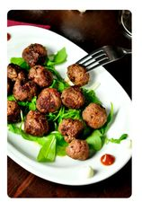
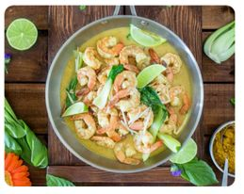
Vitamins and minerals:
Meat is the source of vitamins:
- Vitamin A - liver is the largest source, for cell and tissue growth
- Vitamin B9
- Vitamin B12 - important especially for the elderly
- Iron - very important, especially for growth and development
- Zinc - important for growth, cells and immunity
- Selenium - important for cells, immunity and also prevents tumors

Slide 5
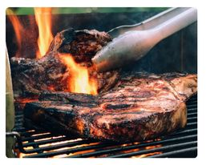
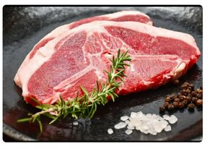
Negative effect of meat on the human body
Barbecue Meat
Meat causes:
cardio-vascular ( heart) disorders and diseases -meat contains a lot of fats and salts.
high consumption of meat causes colon cancer
It causes rise of cholesterol level
scientists say the diseases are caused by high meat consumption and poor cooking.
scientists claim that white meat ( chicken, turkey) is as harmful as red meat ( beef, pork) at high consumption.
healthy meat preparation - boiling, stewing, steaming
unhealthy meat preparation - frying, grilling on an open fire or hot coals, smoking ...
White meat
Red meat

Slide 6
Meat consumption in Slovakia
meat consumption in Slovakia is twice as high as the global average but below average in the European Union
in 2017, the average Slovak consumed 63 kg of meat
in Slovakia, the consumption of pork prevails, followed by poultry
game meat ( wild pig, deer) currently accounts for very little of total meat consumption. 0.9 kg of game meat is consumed. Game meat production fell by more than 60 %
consumption of rabbit meat and other small animals is 2OO g per person.
consumption of lamb, goat and horse meat is 2 00g per person.
Guts ( liver, kidneys) consumption is 2.1 kg per person.

Slide 7
In this table is the expected consumption of meat products in Slovakia per year:
Type of meat product | Consumption per year
bacon | 26 kg
ham | 19 kg
salami | 20 kg
frankfurtiers | 22 kg
sausages | 21 kg
-In the 1990s the consumption of meat and meat products decreased
-In 1990 the consumption of meat was at its highest point, pork dominated, then beef and veal. Total consumption was 84 kg per person
-In 2014, consumption was the lowest, dominated by pork and poultry. Total consumption was 48 kg per person
-Today the consumption of meat is rising again. Total consumption is 63 kg and is dominated by pork and poultry.

Slide 8
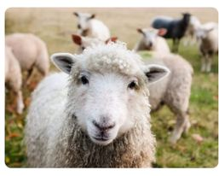
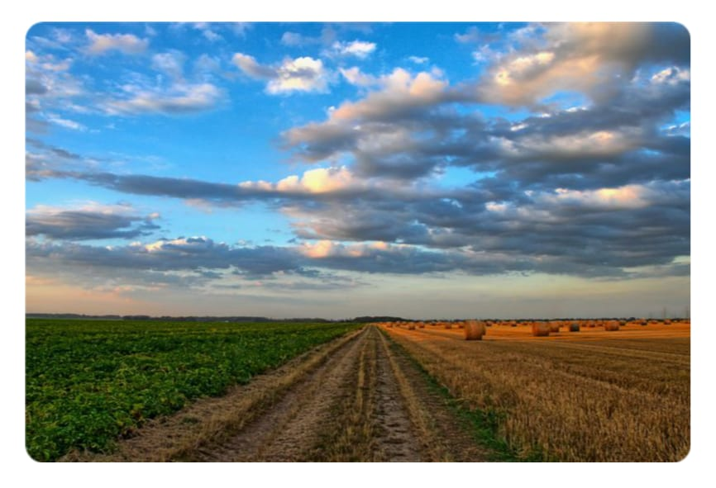
Organic meat in Slovakia
We have about 500 organic farms in Slovakia and they also export goods abroad.
A well-known producers of organic meat in Slovakia are the companies: Bio Meat, Biofarma Príroda Stupava, Biofarma Turie, Ekofarma Važec or Farma Východná.
Farmers never use antibiotics or hormones on animals, cattle ( cows) and sheep are grazing in open spaces
Organic meat is freely available on the market.
Price: organic meat is more expensive than meat from non-organic large-scale farming.
Quality: the quality is much higher than in non-organic breeding.

Slide 9
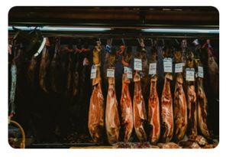
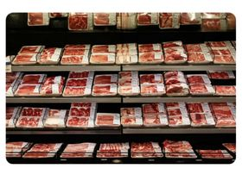
Chicken breast
Turkey breast

Slide 10
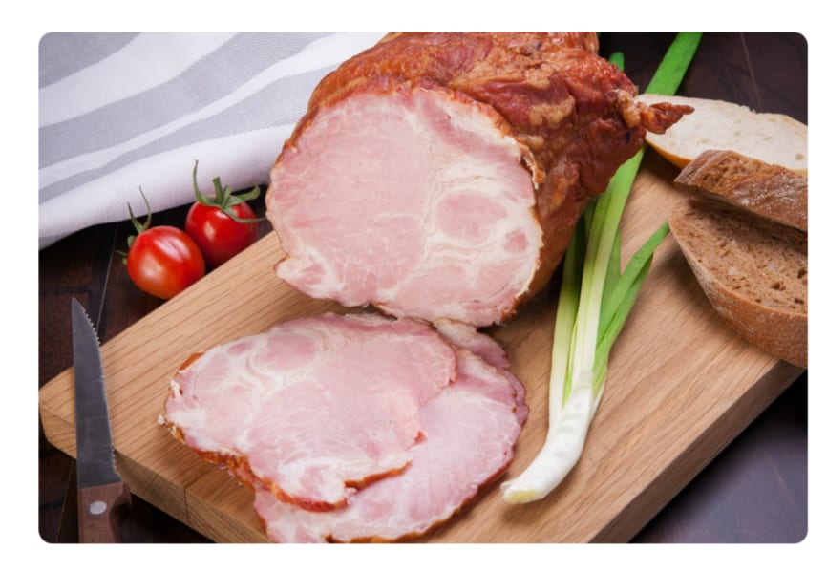
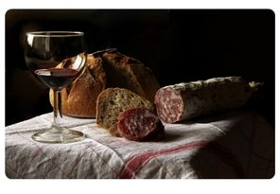
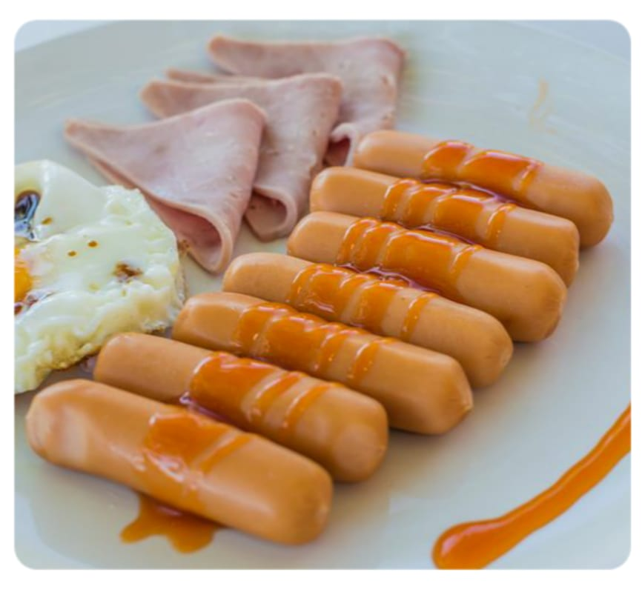
Ham
Salami
Bacon
Wurst

Slide 12
Resources
www.wikipedia.com
www.pixabay.com
www.euractiv.sk
www.dran.webnoviny.sk
www.vpotravinachsavyzname.sk

Slide 13
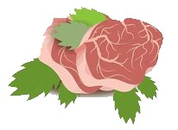
Thank you for your attention

