Slide 1
DISCRIMINATION IN LITHUANIA

Slide 2
FORMS OF DISCRIMINATION
Direct discrimination occurs when one person is treated less favorably than another in the same situation because of racial or ethnic origin, religion or belief, disability, age or sexual orientation. Example of direct discrimination: job advertisement, which states ”we do not accept disabled people”
Restricting or depriving an individual or group of persons of their rights without just cause is called negative discrimination.
Indirect discrimination is a practice that puts people at a disadvantage because of their racial or ethnic origin, religion or belief, disability, age or sexual orientation, unless such practices are justified by legitimate purposes. An example of indirect discrimination may be the requirement of an employer that all candidates for a vacancy take a language test, even if that language is not required for the particular job.
Harassment

Slide 3
The Supreme Administrative Court of Lithuania applied to the Constitutional Court with an inquiry whether certain provisions of the Law on Legal Status of Aliens, which restrict the right of residence to married or registered partners is legal of the Constitution. The applicant – a citizen of Belarus - entered into marriage with a citizen of Lithuania in Denmark. The couple moved to Lithuania, however, the application for residency of a third country national was rejected due to the fact that Lithuanian law explicitly forbids same-sex marriage, hence, under the interpretation of the Law on Legal Status of Aliens by the Migration department and the court of first instance, would not recognise a same-sex couple as family members with regards to the right of residence.

Slide 4
The court provided the interpretation of the Constitution, which in essence rejected the former common practice of the Migration Department under the Ministry of Interior not to issue temporary residence permits to a foreign national who has entered into a same-sex marriage or same-sex registered partnership in another state with a citizen of the Republic of Lithuania who resides in Lithuania on the grounds of public order, ruling that such interpretation is discriminatory and unconstitutional.
Although the Court did not elaborate in detail about sexual orientation or gender identity concepts as such, the wording of the court in combination with its re-affirming statement on the importance of protection of same-sex family relationship lays foundation for further recognition of the rights of samesex couples in Lithuania

Slide 5
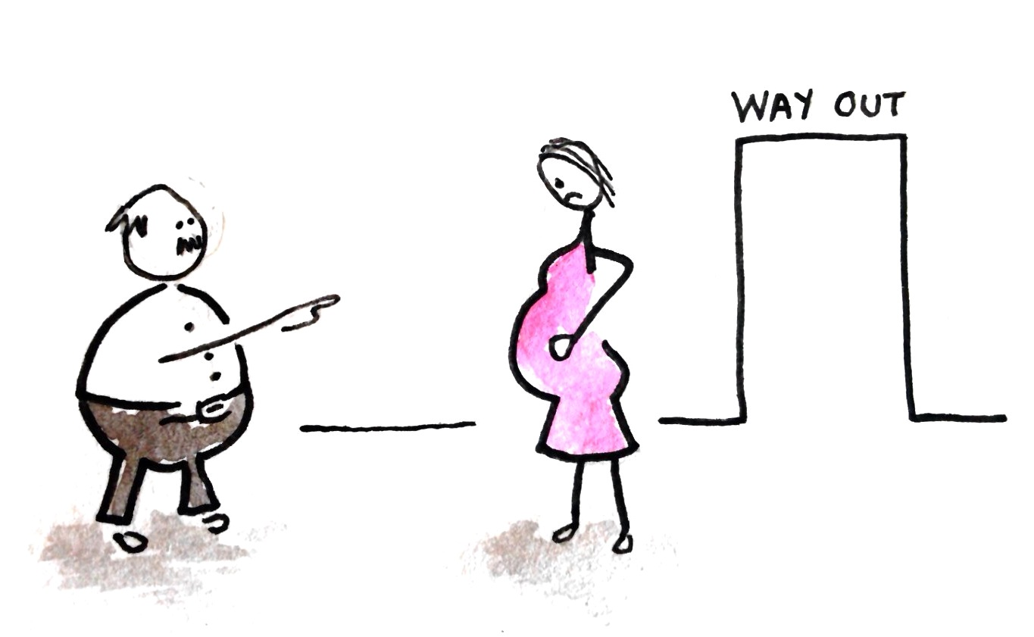
In Lithuania there are currently no specific rules directly prohibiting discrimination in relation to pregnancy and maternity, maternity leave, parental leave, adoption leave and paternity leave. The majority of violations would definitely be covered by the general rules on nondiscrimination in the Labour Code and the EOAWM. Less favourable treatment because of pregnancy, the birth of a child and breastfeeding is only directly prohibited in the area of the provision of services and the sale of goods (Article 7 No 3 of the EOAWM).

Slide 6
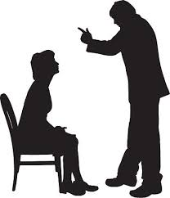
Scope of the prohibition of harassment
Theoretically, the definition of harassment covers all areas which fall within the scope of application of the EOAWM and EOA (actions by state institutions and the provision of services – consumer protection, education, employment, public service, professional organisations). However, provisions expressly addressing harassment as a prohibited act or behaviour are lacking in the legislation. The EOAWM expressis verbis only requires harassment to be actively prevented in an employment relationship. The EOA, which also covers discrimination on the grounds of gender, broadens the scope of this provision to include education

Slide 7
Equal pay
Under labour legislation (Article 26(2) p. 4 of the Labour Code) employers must observe the principle of equal pay for men and women for equal work and work of equal value. In addition, the payment of different wages is prohibited by the EOA and EOAWM.

Slide 8
In Lithuania various persons belonging to different national, ethnic or religious groups face unfavourable treatment. In 2005 the Office of the Equal Ombudsman received 15 complaints concerning discrimination based on ethnicity. According to the data provided by the Centre for Ethnic Studies, Roma people, Chechens, refugees and Muslims are regarded with disfavor most of all in Lithuania. The (Council of Europe) European Commission against Racism and Intolerance has expressed its concern about the complicated situation of refugees and Lithuanian Roma people. Public institutions are incapable of taking effective measures to help socially excluded groups to integrate, while society often tends to condemn them. Careless and unfounded generalisations, such as ‘“they are all like that’“ often harm innocent people, belonging to “disliked“ national or religious groups.

Slide 9
“My name is Kumar Anubhav Tiwari and I am from India. I came here to complete my Research/PhD at Kaunas University of Technology and although job opportunities are very limited for international people, I have got a job as a lecturer at Kaunas University of Technology. It means that there are no barriers for people who have potential and they do not discriminate against people based on nationality or race.
I have to say that Lithuania is a very calm and peaceful country, I urge all international students and people who live in Lithuania not to have bad notions about the country just because of the some bad people. We already know that Lithuanians are really helpful and warm people and if we are good to them, they will return their best.”

Slide 10
https://www.youtube.com/watch?v=4viXOGvvu0Y

Slide 11
THANK YOU FOR YOUR ATTENTION!

