Slide 1
Traditional Jamaican
Christmas dishes

Slide 2
Recipe for Jamaican
Macaroni and Cheese
🧀 RECIPE FOR MAC & CHEESE🧀
To make a mac and cheese you need:
a piece of butter
2 cups of milk
3 tablespoons of mayonnaise
2 teaspoons of paprika
1 teaspoon of salt
1 teaspoon of pepper
20 slices of cheddar cheese
long-ripening cheese
1 pack of macaroni
First, cook the pasta. Secondly, heat the milk and add butter, mayonnaise, long-aged cheese, paprika, salt, pepper and about 10 slices of cheddar. Next mix the macaroni and sauce, add the rest of the cheese to the top of the dish. Bake it in the cooker for 20 minutes at 180°.
We believe you like it and Bon Appetit!🎅💗💛🧀🥘🎄

Slide 3
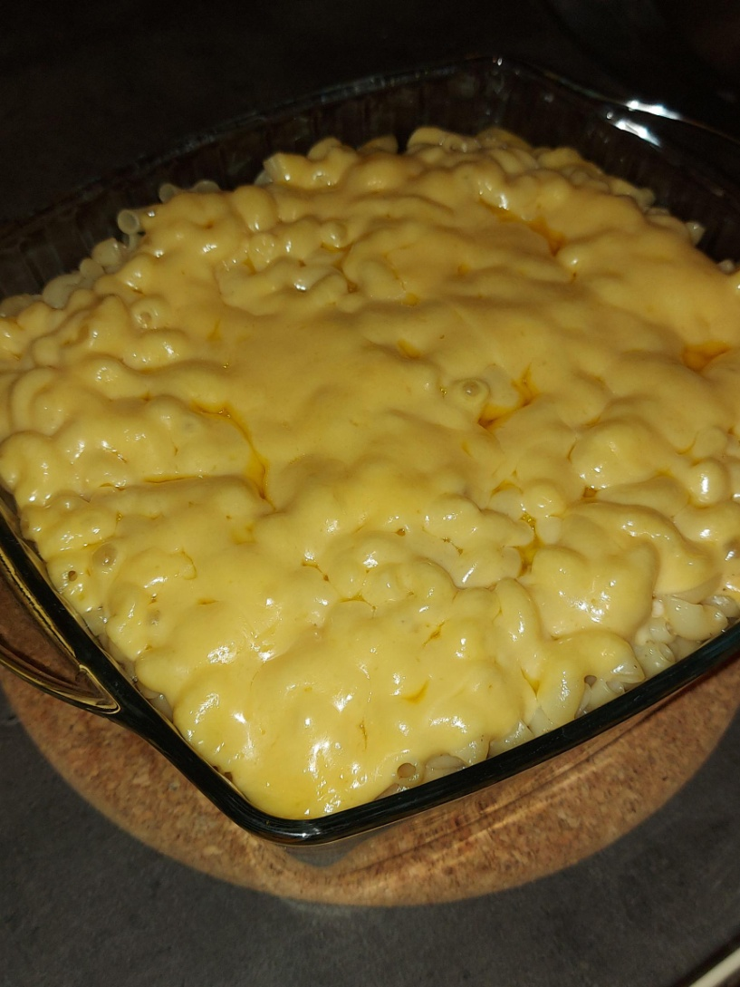
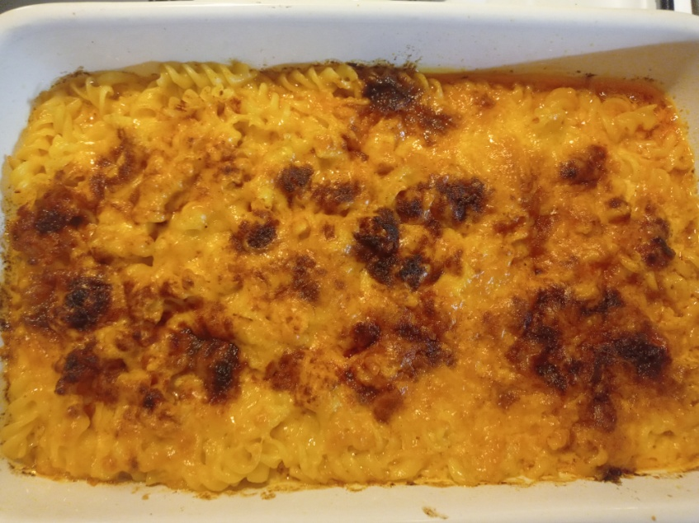
Baked Macaroni and Cheese

Slide 4
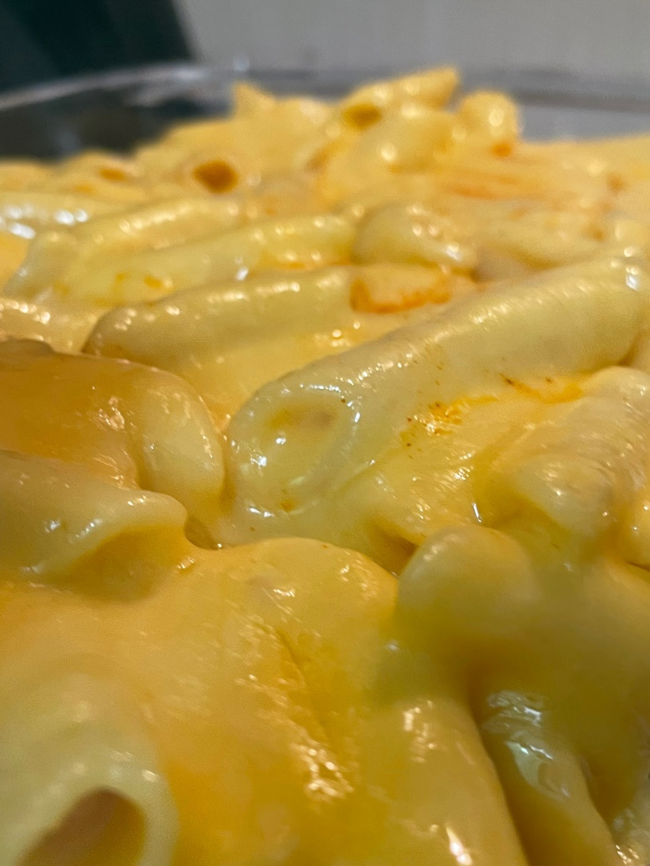
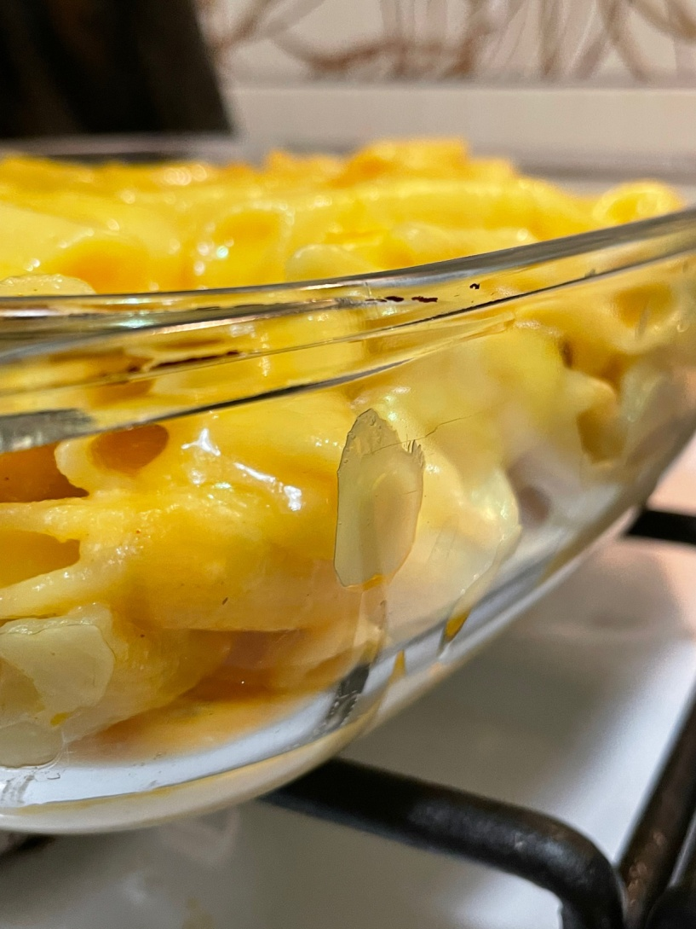
Baked Macaroni and Cheese

Slide 5
Recipe for Jamaican Fruit Cake
INGREDIENTS
PREPARATION
Cream butter and sugar.
Beat eggs thoroughly.
Add to the creamed butter and sugar.
Add flour 1 cup at a time (sift flour).
Add baking powder and salt.
Stir in fruits, mixed spice, vanilla and molasses until you get a smooth paste.
Bake for 80-90 minutes at 180 degrees.
3 cups flour
3 cups sugar (brown)
2 cups butter
3 tsp. baking powder
1 dozen eggs
1/2 lb. mixed fruits
1/2 lb. raisins
1/2 c. molasses
1 tbsp. vanilla
1 tsp. salt
1 tsp. mixed spice

Slide 6
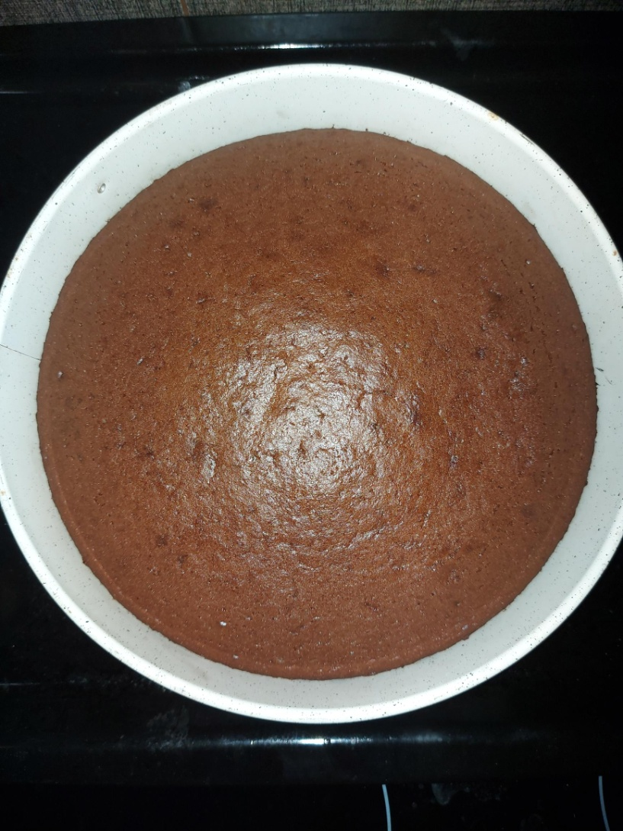
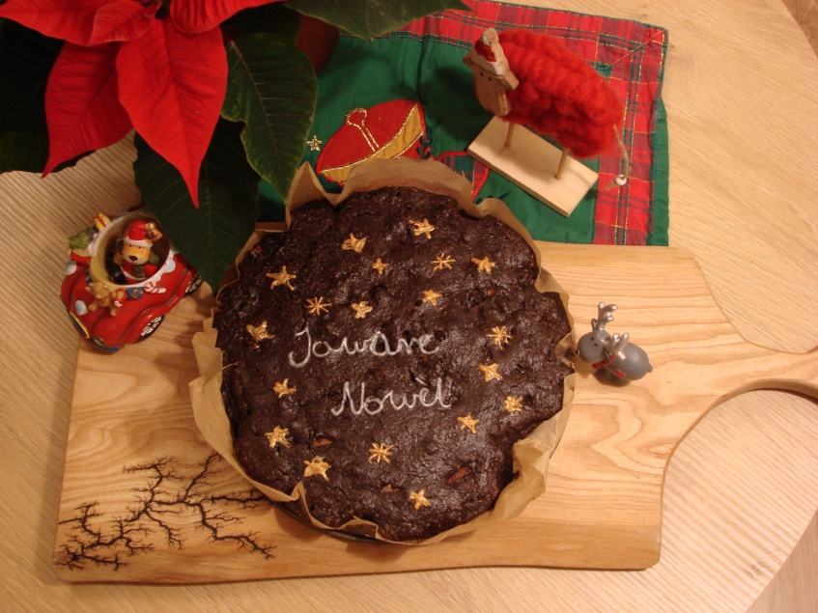
Fruit Cake

Slide 7

Jamaican main dish video

